Slide 1
Cracking the Code: Controversies in ACLS Pharmacotherapy
Sam Markle, PharmD., BCPS
PGY-2 Critical Care Pharmacy Resident
Mentor:
Gianna Vitale, PharmD., BCCCP

Slide 2
Disclosures
Sam Markle has no relevant financial relationships with ineligible companies to disclose

Slide 3
Objectives
After this presentation, pharmacists will be able to:
I
Describe the utility of common interventions in ACLS
II
Review the evidence supporting epinephrine in ACLS
III
Discuss the controversial role of vasopressin and VSE in cardiac arrest
IV
Compare outcomes between amiodarone and lidocaine in shockable arrest

Slide 4
Abbreviations
OHCA – Outside Hospital Cardiac Arrest
IHCA – Inside Hospital Cardiac Arrest
VF – Ventricular Fibrillation
pVT – Pulseless Ventricular Tachycardia
PEA – Pulseless Electrical Activity
CPR – Cardiopulmonary Resuscitation
BLS – Basic Life Support
ACLS – Advanced Cardiac Life Support

Slide 5
Cardiac Arrest Background
Defined as the cessation of mechanical cardiac activity, confirmed by the absence of signs of circulation
Generally categorized according to two major classifications:
Setting
Rhythm
Outside Hospital (OHCA)
Inside Hospital (IHCA)
Shockable (VF/pVT)
Nonshockable (PEA/Asystole)
Tsao et al. Circulation. 2022.

Slide 6
Cardiac Arrest Epidemiology
Patient outcomes are generally poor
Group | OHCA |  | IHCA
 | Survival to Discharge | Favorable Neurologic Outcome | Survival to Discharge | Favorable Neurologic Outcome
All patients | 9.0% | 7.0% | 23.3% | 17.8%
Initial Rhythm
VF/pVT | 25.6% | 22.6% | 49% | -
PEA/Asystole | 5.5% | 3.9% | 10.5% | -
Tsao et al. Circulation. 2022.
Notes:
Patient outcomes are generally poor
IHCA is associated with more favorable outcomes, owing to faster time to intervention, professional expertise, and underlying cause management
Shockable rhythms also result in better outcomes on average, mainly due to the ability to terminate the cause with defibrillation.
Neurologic outcome denoted with CPC ½

Slide 7
Cardiac Arrest Management
Advanced Cardiac Life Support (ACLS)
Basic Life Support
Treatment of Underlying Causes
High-Quality CPR
Defibrillation
Advanced Airway Management
Pharmacotherapy
Panchal et al. Circulation. 2020.
Stiell et al. NEJM. 2004.
Sanghavi et al. JAMA Int Med. 2015.
Notes:
Only interventions associated with favorable neurologic outcomes = high-quality CPR and early defibrillation

Slide 8
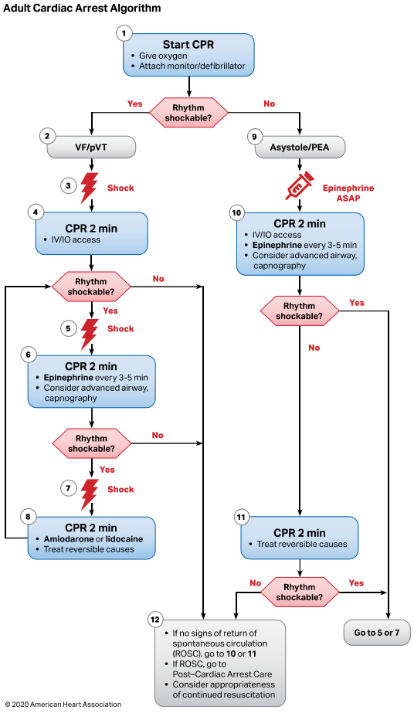
Advanced Cardiac Life Support (ACLS)
Panchal et al. Circulation. 2020.

Slide 9
Pharmacotherapy in ACLS
Rationale:
Assist in the restoration of cardiac activity and improve favorable outcomes
Standard Medications
Optional Medications
Epinephrine
Amiodarone
Lidocaine
Alteplase
Calcium chloride
Dextrose
Insulin
Sodium bicarbonate
Steroids
Vasopressin
Panchal et al. Circulation. 2020.

Slide 10
Question I
Which of the following ACLS interventions are associated with improvement in neurologic outcomes at hospital discharge (select all that apply)?
Chest compressions
Early defibrillation
Epinephrine
Antiarrhythmic drugs

Slide 11
Outcomes in Cardiac Arrest Literature
Return of Spontaneous Circulation (ROSC)
Survival to Hospital Admission
Survival to Hospital Discharge
Survival with Favorable Neurologic Outcome
Notes:
Define terms – most commonly utilized metrics in cardiac arrest literature -> primer for further discussion
Favorable neurologic outcome – as defined by CPC or mRS scoring, where favorable outcomes = ability to return home with independence in activities of daily living
Favorable neurologic outcome is seen as the gold standard in cardiac arrest literature due to it being a long-term, patient centered outcome, but is very difficult to appropriately power for this outcome, given patients have to achieve ROSC and survival first, and there is substantial loss during each of these phases.

Slide 12
Pharmacotherapy Overview
Epinephrine
Vasopressin
Vasopressin, Steroids + Epinephrine (VSE)
Antiarrhythmic Drugs

Slide 13
Epinephrine

Slide 14
Epinephrine Pharmacotherapy
Mechanism of action:
Combined α + β adrenergic agonist
Rationale for Use:
α-adrenergic agonism leads to arterial vasoconstriction
Augments coronary perfusion -> improved ROSC
Increases cerebral perfusion -> better neurological outcomes
β-adrenergic agonism may improve contractility
Ristagno et al. Crit Care Med. 2009.
Jacobs et al. Resuscitation. 2011.
Perkins et al. NEJM. 2018.
Notes:
Augments coronary perfusion via increasing aortic perfusion pressure, leading to increased aortic perfusion
Arrhythmia risk may lead to decreased efficacy in shockable cardiac arrest
Decreased microcirculatory flow may be due to increased thrombosis risk generated by alpha agonism, or may be vasocontriction = impaired blood flow

Slide 15
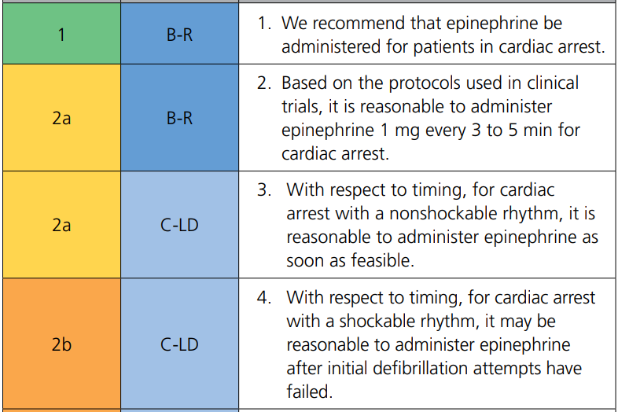
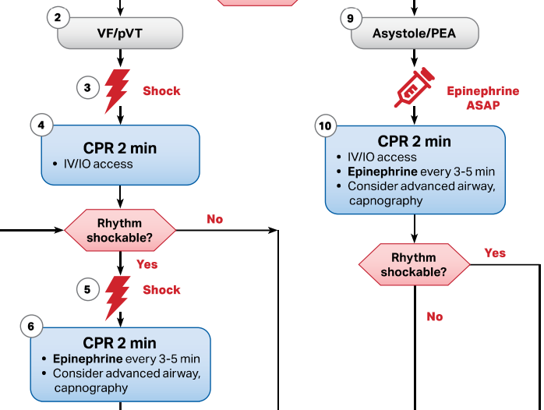
Role in Therapy
2020 AHA Guidelines
2020 ACLS Algorithm
2021 ERC Guidelines = Same recommendations, but wait until after 3rd shock in pVT/VF
Dose
1 mg IV (IO) every 3-5 min or with every other pulse check
Panchal et al. Circulation. 2020.
Soar et al. Resuscitation. 2021.

Slide 16
Adverse Effects of Epinephrine
Adverse Effects
β-adrenergic stimulation
Enhanced arrhythmia risk
Increased myocardial oxygen demand
Decreased microcirculatory cerebral blood flow in animal models
Ristagno et al. Crit Care Med. 2009.
Jacobs et al. Resuscitation. 2011.
Perkins et al. NEJM. 2018.

Slide 17
Controversies
Utility in cardiac arrest due to ventricular arrhythmias
Does improvement in perfusion outweigh arrhythmia risk?
Timing of drug administration
Would earlier administration = better outcomes?
Optimal dose
Will higher dosing lead to greater efficacy?
Effect on overall patient outcomes
What clinically important outcomes are improved with epinephrine?
Holmberg et al. Resuscitation. 2019.
Notes:
Rationale = enhancement of perfusion, ↑ ROSC earlier -> better neurologic outcomes due to shorter low-flow time
Keep these questions in mind as we discuss the literature for epinephrine – let us start with the final question

Slide 18
PACA (2011)
Single-center, double-blind RCT
N = 534
Population: OHCA
Epinephrine
(1 mg q3 min)
Placebo
(q3 min)
Trial Characteristics:
No information on timing of drug administration
Initial rhythm = VF/pVT in 45.8%, PEA in 30.1%, and Asystole in 24.1%
vs.
Primary Outcome: Survival to Hospital Discharge
Jacobs et al. Resuscitation. 2011.
Notes:
No information on timing of epinephrine (mean ambulance time = 10 min, so at least ~12-15 min?)

Slide 19
PACA (2011) - Results
Epinephrine led to:
ROSC pre-hospital (23.5% vs. 8.4%, p < 0.001)
Survival to hospital admission (25.4% vs. 13.0%, p < 0.001)
Survival to hospital discharge (4.0% vs. 1.9%)
Favorable neurologic function in survivors (81.8% vs. 100%, p = 0.31)
9/11
5/5
ROSC
Non-Shockable – OR 6.9
Shockable – OR 2.4
Survival to Admission
Non-Shockable – OR 2.5
Shockable – OR 2.2
Jacobs et al. Resuscitation. 2011.
Notes:
Discuss implications of point-estimate suggesting increased neurologic harm despite more survival with epinephrine
Survival increase at expense of neuro function
Overall very poor outcomes (even compared to general OHCA)

Slide 20
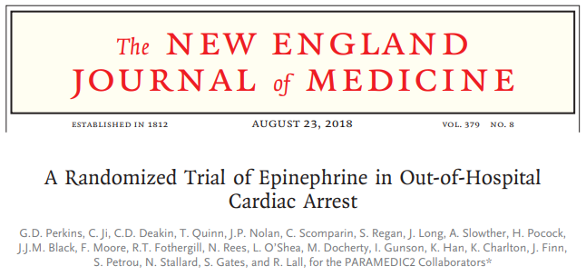
PARAMEDIC2 (2018)
Multicenter, double-blind RCT
N = 8014
Population: OHCA
Trial Characteristics:
Median time to drug administration = 21 min from EMS call
79% of patients had non-shockable rhythm (53% asystole)
Epinephrine
(1 mg q3-5 min)
Placebo
(q3-5 min)
vs.
Primary Outcome: 30-day Survival
Perkins et al. NEJM. 2018.

Slide 21
PARAMEDIC2 (2018) - Results
Outcome | Epinephrine | Placebo | Odds Ratio (95% CI)
Survival at 30 days | 3.2% | 2.4% | 1.47 (1.09 to 1.97)
Pre-Hospital ROSC | 36.3% | 11.7% | --
Survival to Hospital Admission | 23.8% | 8.0% | 3.83 (3.30 to 4.43)
Survival to Hospital Discharge | 3.2% | 2.3% | 1.48 (1.10 to 2.00)
Survival with Favorable Neurologic Outcome | 2.2% | 1.9% | 1.19 (0.85 to 1.68)
Perkins et al. NEJM. 2018.

Slide 22
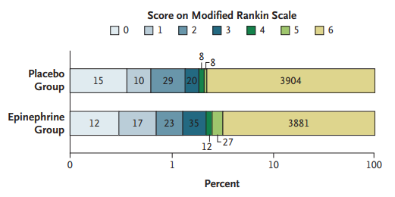
PARAMEDIC2 (2018) – Results II
Subgroup Analysis:
Perkins et al. NEJM. 2018.
Notes:
Severe neurologic impairment [mRS 4-5] was more common among survivors in epinephrine group (31.0% vs. 17.8%), making ultimate outcome of poor neurologic outcome and death similar between groups, leading to the argument that epinephrine makes no difference for long-term outcomes.

Slide 23
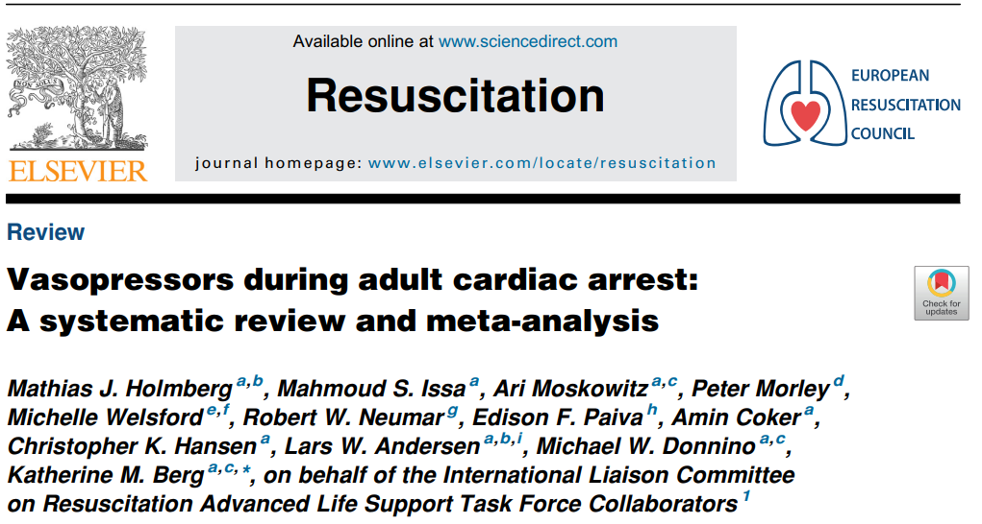
Holmberg et al. (2019)
Systematic Review and Meta-Analysis
Inclusion: Age ≥ 18, RCT or non-randomized trial or observational study
Exclusion: VSE studies, studies on epinephrine dose comparisons
Holmberg et al. Resuscitation. 2019.

Slide 24
Holmberg et al. (2019) - Epinephrine
Comparison: Epinephrine vs. Placebo
Studies: 2 RCTs (N = 8469)
Epinephrine:
ROSC (RR 3.09 [2.82 to 3.39], high certainty)
Survival to hospital admission (RR 2.88 [2.57 to 3.22], high certainty)
Survival to hospital discharge (RR 1.44 [1.11 to 1.86], moderate certainty)
Favorable neurologic outcome (RR 1.21 [0.90 to 1.62], moderate certainty)
Subgroup Analysis:
Non-shockable Rhythms - ROSC + Survival to Hospital Discharge
Shockable Rhythms - ROSC only
Earlier administration associated with improved rates of ROSC
Holmberg et al. Resuscitation. 2019.
Notes:
Another major finding across both trials was a temporal association with earlier epinephrine administration leading to improved rates of ROSC. This was further explored in a few studies across OHCA/IHCA.

Slide 25
Timing of Epinephrine - OHCA
Okubo et al. (2021)
Every 1-minute delay from EMS arrival to epinephrine administration associated with
Non-Shockable
Shockable
RR of Survival by 4.4%
RR of Favorable Neurologic Outcome by 7.1%
RR of Survival by 5.5%
RR of Favorable Neurologic Outcome by 6.4%
Andersen et al. BMJ. 2016.
Okubo et al. JAMA Netw Open. 2021.
Donnino et al. BMJ. 2014.
Notes:
PACA + PARAMEDIC2 showed that faster time to administration = better outcomes
In OHCA -> faster = better in all cases

Slide 26
Timing of Epinephrine - IHCA
Donnino et al. (2014) – Non-Shockable
Early
= Better
Stepwise in survival with prolonged time to epinephrine administration (p < 0.001)
Andersen et al. (2016) - Shockable
Early
= Worse
survival when epinephrine given within 2 minutes of first defibrillation – OR 0.70 [0.59 to 0.82]
Donnino et al. BMJ. 2014.
Andersen et al. BMJ. 2016.
Notes:
Donnino
Delays > 7 mins from arrest onset associated with ↓ survival vs. 1-3 min
Andersen
Propensity matched cohort – harm was noted relative to more rapid administration prior to failing defibrillation (non-guideline recommended, but gives evidence against early use that builds in other studies)

Slide 27
Epinephrine Dose
Study | Population | Comparison | Survival with CPC 1 or 2 | Survival to Discharge | Survival to Admission | ROSC
Callaham et al. (1992) | OHCA N = 816 | HDE (15 mg) vs. SDE (1 mg) | - (p = 0.10) | - (p = 0.37) | + (p = 0.02) | + (p = 0.01)
Brown et al. (1992) | OHCA N = 1280 | HDE (0.2 mg/kg) vs. SDE (0.02 mg/kg) | N/A | - (p = 0.98) | - (NR) | - (NR)
Stiell et al. (1992) | All CA N = 650 | HDE (7 mg) vs. SDE (1 mg) | - (p = 0.24) | - (p = 0.38) | N/A | - (p = 0.12)
Choux et al. (1995) | OHCA N = 536 | HDE (5 mg) vs. SDE (1 mg) | N/A | N/A | - (NR) | - (NR)
Sherman et al. (1997) | All CA N = 140 | HDE (0.1 mg/kg) vs. SDE (0.01 mg/kg) | - (NR) | - (NR) | N/A | - (p = 0.25)
Gueugniaud et al. (1998) | OHCA N = 3327 | HDE (5 mg) vs. SDE (1 mg) | - (p = 0.40) | - (p = 0.78) | + (p = 0.05) | + (p = 0.02)
Callaham et al. JAMA. 1992.
Brown et al. NEJM. 1992.
Stiell et al. NEJM. 1992.
Choux et al. Resuscitation. 1995.
Sherman et al. Pharmacotherapy. 1997.
Gueugniaud et al. NEJM. 1998.
Notes:
Inconsistent benefit with ROSC/survival to admission, higher risk for harm, and no long term benefit have led to the recommendation to avoid HDE in routine clinical practice.`
2015 International Consensus on CPR – Meta-Analysis
HDE improves ROSC and survival to hospital admission, but no benefit in survival to discharge or neurologic outcomes
Recommend against routine use

Slide 28
Epinephrine Summary
Non-Shockable
Shockable
ROSC
Survival to Admission
Survival to Discharge
ROSC
Survival to Admission
Survival to Discharge
No impact on favorable neurologic survival
Earlier administration may improve outcomes
No clinical benefit with high-dose epinephrine
Holmberg et al. Resuscitation. 2019.
Notes:
Patients with non-shockable rhythms benefit more from epinephrine
Shockable rhythms still saw benefit in trials

Slide 29
Question II
Based on the currently available evidence, epinephrine has demonstrated improvement in all of the following except?
ROSC
Survival to Hospital Admission
Survival to Hospital Discharge
Favorable Neurologic Survival

Slide 30
Vasopressin

Slide 31
Vasopressin Pharmacotherapy
Mechanism of action:
V1 Receptor Agonist -> arterial vasoconstriction
Role in cardiac arrest = similar to epinephrine
Rationale for Use:
Relative endogenous vasopressin deficiency in cardiac arrest
Non-catecholamine vasopressor
Retains activity in severe acidosis
Avoids sympathetic adverse effects
Theorized Target Patient Population:
Prolonged cardiac arrest with profound acidosis
Ventricular arrhythmias
Wenzel et al. NEJM. 2004.
Gueugniaud et al. NEJM. 2008.

Slide 32
Role in Practice
Proposed Options:
Alternative to epinephrine
Combination therapy with epinephrine
Guideline Recommendations:
Vasopressin (40 units) may replace the 1st or 2nd dose of epinephrine in the treatment of cardiac arrest (Class IIb)
2005
AHA Guidelines
2015
AHA Guidelines
2020
AHA Guidelines
Vasopressin offers no advantage over epinephrine in cardiac arrest (Class IIb) or in combination with epinephrine (Class IIb)
Removed from ACLS algorithm
Circulation. 2005.
Neumar et al. Circulation. 2010.
Link et al. Circulation. 2015.
Panchal et al. Circulation. 2020.
Soar et al. Resuscitation. 2021.

Slide 33
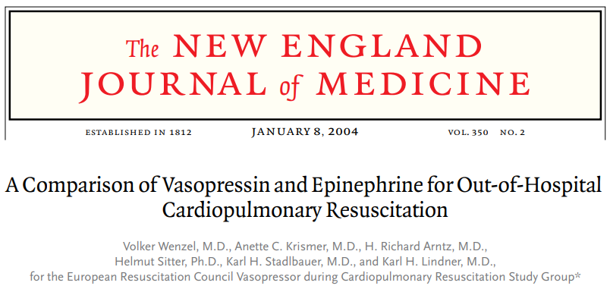
Wenzel et al. (2004)
Multicenter, double-blind RCT
N = 1186
Population: OHCA
Trial Characteristics:
Mean 18 minutes from arrest to drug administration
45% had asystole, 40% had VF/pVT, 15% had PEA
Vasopressin
(40 units q3-5 min)
Epinephrine
(1 mg q3-5 min)
vs.
Primary Outcome: Survival to Hospital Admission
Wenzel et al. NEJM. 2004.
Notes:
Allowed up to 2 doses of vasopressin

Slide 34
Wenzel et al. (2004) - Results
No difference between groups for:
ROSC
24.6% vs. 28.0%
(p = 0.19)
Survival to Admission
36.3% vs. 31.2%
(p = 0.06)
Survival to Discharge
9.9% vs. 9.9%
(p = 0.99)
Favorable Neurologic Outcome
3.23% vs. 3.45%
(p = 0.99)
No difference in outcomes between rhythm type
survival to admission by 40% with vasopressin in asystole
No harm associated with vasopressin
Wenzel et al. NEJM. 2004.
Notes:
Trial demonstrates no benefit with vasopressin over epinephrine in routine use, but no evidence of harm/worse outcomes and may provide benefit in specific patient populations
Asystole findings would be consistent with benefit in patients with more profound acidosis, but inconclusive. Total of 528 patients with asystole, which is fairly large if found in own trial

Slide 35
Gueugniaud et al. (2008)
Multicenter, double-blind RCT
N = 2894
Population: OHCA
Trial Characteristics:
Majority of patients (83%) had asystole
Mean 21-22 minutes from collapse to first drug administration
Vasopressin + Epinephrine
Epinephrine
Alone
vs.
Primary Outcome: Survival to Hospital Admission
Gueugniaud et al. NEJM. 2008.

Slide 36
Gueugniaud et al. (2008) - Results
Post-hoc analysis demonstrated survival to hospital discharge with combination therapy in patients with initial PEA (0% vs. 5.8%, p = 0.02)
Gueugniaud et al. NEJM. 2008.
Notes:
Results in primarily asystole patient population is in contrast to prior trial post-hoc analysis
Low rate of shockable rhythms -> potential area for benefit with vasopressin

Slide 37
Holmberg et al. (2019) - Vasopressin
Comparison: Vasopressin vs. Epinephrine
Studies:
Vasopressin vs. Epinephrine - 3 RCTs (N = 1562)
Combination Therapy vs. Epinephrine Alone – 3 RCTs (N = 3249)
Vasopressin vs. Epinephrine
Combination vs. Epinephrine
No difference in any outcomes between groups
s
No difference in any outcomes between groups
s
Holmberg et al. Resuscitation. 2019.

Slide 38
Vasopressin Summary
No difference in outcomes with vasopressin vs. epinephrine
No suggestion for harm with vasopressin
Personal Conclusion:
Vasopressin offers no benefit over epinephrine and use cannot be routinely recommended
Vasopressin may still have niche in profound acidosis or VF/pVT arrest
Higher cost
More difficult to prepare
Equally effective
May benefit certain patients
Notes:
Overall data is limited supporting vasopressin in cardiac arrest -> 2 major trials only
Data is also limited to OHCA, predominantly non-shockable rhythms, and participants only received a max of 2 doses
Two ways to view data -> no role for vasopressin given lack of benefit, or potential role given no difference in outcomes compared to epinephrine
Interpretation largely contingent on practical application – more difficult to implement vasopressin IV push in current practice, limiting use compared to epinephrine
However, vasopressin data doesn’t stop here, as it is a major component of another controversial treatment modality

Slide 39
Question III
Which of the following statements accurately represents the current evidence for the use of vasopressin in cardiac arrest?
Vasopressin alone improves survival to discharge vs. epinephrine
Vasopressin + epinephrine is superior to epinephrine alone
Vasopressin is more effective in PEA than epinephrine
Vasopressin does not improve outcomes vs. epinephrine

Slide 40
Vasopressin, Steroids and Epinephrine (VSE)

Slide 41
VSE Pharmacotherapy
Rationale for use:
Epinephrine + Vasopressin -> arterial vasoconstriction
Corticosteroids
Enhances myocardial contractility
Reversal of relative adrenal insufficiency
Attenuation of systemic inflammatory response
Potentiation of vasopressor activity
Several small studies have demonstrated improved ROSC and survival in patients treated with steroids during and after cardiac arrest
Prigent et al. Crit Care. 2004.
Tsai et al. Am J Emerg Med. 2007.
Tsai et al. Int J Cardiology. 2016.
Tsai et al. Crit Care Med. 2019.
Liu et al. J Int Med Res. 2020.
Andersen et al. JAMA. 2021.
Ito et al. Resuscitation. 2004.
Notes:
Specifically methylprednisolone has been shown to improve myocardial contractility, while HCT has demonstrated greater benefit in reversal of adrenal insufficiency and SIRS attenuation

Slide 42
Mentzelopoulos et al. (2009)
Single-center, double-blind RCT
N = 100
Population: IHCA
Trial Characteristics:
Initial rhythm was asystole in 62%, PEA in 23%, and VF/pVT in 15%
Mean time to ACLS was 1 min
Vasopressin + Epinephrine + Methylprednisolone
Epinephrine
Alone
vs.
Hydrocortisone 300 mg daily x 7 days
Placebo
Primary Outcome: ROSC ≥ 15 min + Survival to Hospital Discharge
Mentzelopoulos et al. Arch Intern Med. 2009.
Notes:
VSE Protocol = Methylprednisolone 40 mg x 1 dose and Vasopressin 20 units + Epinephrine 1 mg q2-3min up to max 5 cycles
If ROSC achieved, VSE group would receive 300 mg hydrocortisone daily x 7 days

Slide 43
Mentzelopoulos et al. (2009) - Results
VSE led to:
ROSC (81% vs. 52%, p = 0.003)
Survival to hospital discharge (18.8% vs. 3.8%, p = 0.02)
More rapid attainment of ROSC
Patients with post-resuscitation shock had survival with steroids
29.6% vs. 0%, p = 0.02
Mentzelopoulos et al. Arch Intern Med. 2009.
Notes:
Limited by small population, single-center, and no data on neurologic outcomes, so further study was necessary to validate findings

Slide 44
Mentzelopoulos et al. (2013)
Multicenter, double-blind RCT
N = 268
Population: IHCA
Trial Characteristics:
Initial rhythm was asystole in 65-70%, PEA 15-20%, and pVT/VF in 17%
Time to ACLS was ~2 min
Vasopressin + Epinephrine + Methylprednisolone
Epinephrine
Alone
vs.
Hydrocortisone 300 mg daily x 7 days
Placebo
Primary Outcome: ROSC ≥ 20 min + Survival to Hospital Discharge with CPC 1 or 2
Mentzelopoulos et al. JAMA. 2013.
Notes:
VSE Protocol = Methylprednisolone 40 mg x 1 dose and Vasopressin 20 units + Epinephrine 1 mg q2-3min up to max 5 cycles
If ROSC achieved, VSE group would receive 300 mg hydrocortisone daily x 7 days

Slide 45
Mentzelopoulos et al. (2013) - Results
VSE led to:
ROSC (83.9% vs. 65.9%, p = 0.005)
Survival to hospital discharge with Favorable Neurological Outcome (13.9% vs. 5.1%, p = 0.02)
Duration of ACLS (13 vs. 19 min, p = 0.01)
Validates prior study with larger population and neurologic outcomes
Mentzelopoulos et al. JAMA. 2013.
Notes:
NNT = 12 for neurologic outcome
Decreased ACLS duration likely driver for efficacy
Trial helps to validate prior study through larger population, multicenter (3), and examining neurologic outcomes, which are more patient centered
Still single trialist group with fragile results -> needs additional validation for practice

Slide 46
VAM-IHCA (2021)
Multicenter, double-blind RCT
N = 501
Population: IHCA
Trial Characteristics:
Majority of patients had non-shockable rhythm (90%)
Mean duration to trial drug was ~8 min
Vasopressin + Epinephrine + Methylprednisolone
Epinephrine
Alone
vs.
No Protocolized Post-Arrest Steroids
Primary Outcome: ROSC ≥ 20 min
Andersen et al. JAMA. 2021.

Slide 47
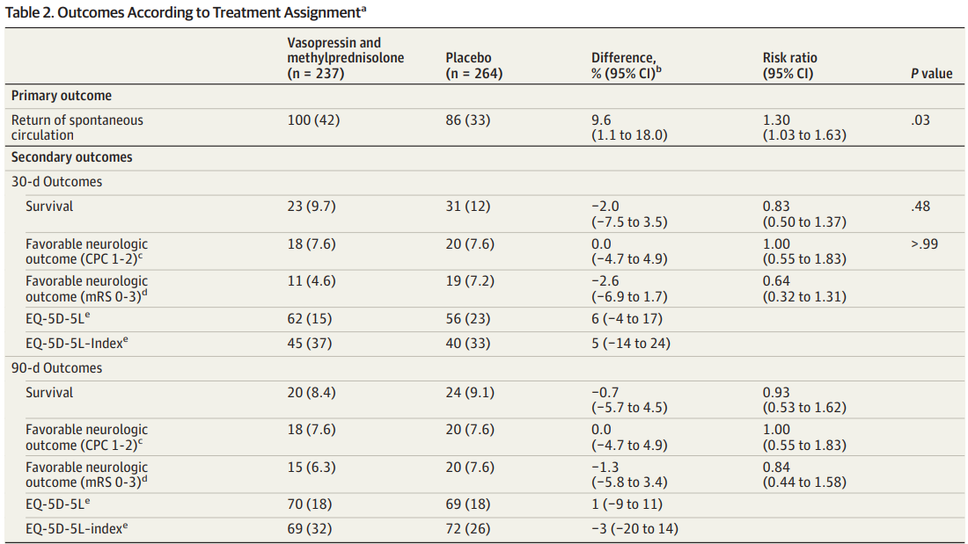
VAM-IHCA (2021) - Results
Andersen et al. JAMA. 2021.
Notes:
VSE ↑ ROSC vs. epinephrine, but failed to change survival or favorable neurologic outcomes at 30 days compared to epinephrine alone
Subgroup analysis demonstrated better outcomes for ROSC with faster drug administration (RR 1.46 if ≤ 8 min) and in patients with non-shockable rhythms
Post-arrest steroids not protocolized
May result in differences seen between trials on survival outcomes
More patients in control group received steroids (24% vs. 46%, p = 0.01), biasing towards the null for these outcomes
Potential selection bias with 170 patients excluded for unknown reasons

Slide 48
VSE Limitations
Mentzelopoulos Trials
Prompt ACLS initiation (within 1-2 min)
Single trial group in Greece
N = 368 total
VAM-IHCA
Slower time to drug administration
Lack of post-arrest steroid protocolization
Not powered for long-term outcomes
Overall
Only studied in IHCA
Predominantly evaluated in non-shockable rhythms
Multi-intervention confounding effect
Mentzelopoulos et al. Arch Intern Med. 2009.
Mentzelopoulos et al. JAMA. 2013.
Andersen et al. JAMA. 2021.

Slide 49
VSE Summary
IHCA
VSE Therapy, compared to epinephrine alone:
Consistently ROSC
May survival and favorable neurological outcomes
Conflicting data
No suggestion of harm
Discussion:
Should we use VSE in routine clinical practice?
Mentzelopoulos et al. JAMA. 2013.
Mentzelopoulos et al. Arch Intern Med. 2009.
Andersen et al. JAMA. 2021.

Slide 50
Question IV
Which of the following outcomes was most consistently demonstrated with the Vasopressin, Steroids and Epinephrine trials?
ROSC
Survival to Hospital Admission
Survival to Hospital Discharge
Favorable Neurological Outcomes

Slide 51
Antiarrhythmic Drugs: Amiodarone vs. Lidocaine

Slide 52
Antiarrhythmic Drugs in ACLS
Used in patients with VF/pVT refractory to defibrillation
Rationale:
Chemical cardioversion to restore perfusing rhythm
Lowers defibrillation threshold
Two drugs primarily used:
Amiodarone
Lidocaine
Panchal et al. Circulation. 2020.

Slide 53
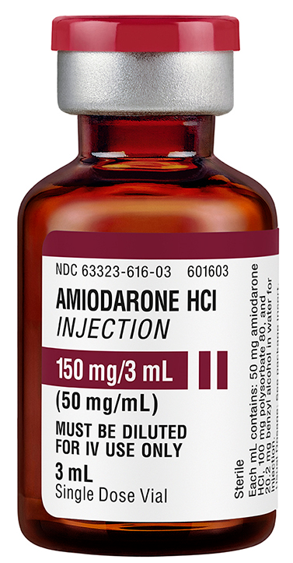
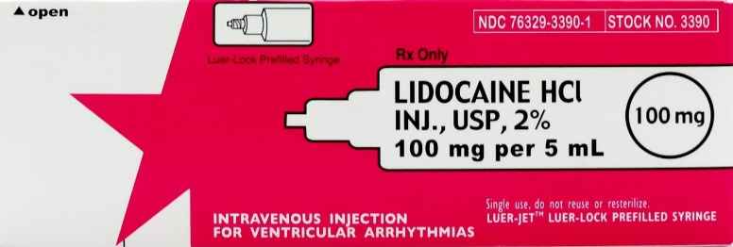
Amiodarone vs. Lidocaine
Amiodarone
Lidocaine
Mechanism: Class III antiarrhythmic with effects on α/β receptors + Na/K/Ca channels
Dose:
Initial = 300 mg
Repeat = 150 mg
Adverse Effects:
Hypotension
Bradycardia
Mechanism: Class 1b antiarrhythmic (Na channel blocker)
Dose:
Initial = 1-1.5 mg/kg
Repeat = 0.5-0.75 mg/kg
Adverse Effects:
Seizures
Bradycardia
Fresenius Kabi. Amiodarone.
McGuff Medical. Lidocaine.
Lexicomp. Amiodarone.
Lexicomp. Lidocaine.

Slide 54
Guideline Recommendation History
2020 AHA Guidelines
Amiodarone may be considered when VF/pVT is unresponsive to CPR, defibrillation, and vasopressor therapy (Class IIb)
If amiodarone is unavailable, lidocaine may be considered (Class IIb)
Amiodarone or lidocaine may be considered for VF/pVT unresponsive to defibrillation (Class IIb)
2005
AHA Guidelines
2015
AHA Guidelines
2018
AHA Update
Amiodarone may be considered for VF/pVT unresponsive to CPR, defibrillation and vasopressor therapy (Class IIb)
Lidocaine may be considered as an alternative to amiodarone (Class IIb)
Circulation. 2005.
Neumar et al. Circulation. 2010.
Link et al. Circulation. 2015.
Panchal et al. Circulation. 2018.
Panchal et al. Circulation. 2020.
Soar et al. Resuscitation. 2021.

Slide 55
ARREST (1999)
Multicenter, double-blind, placebo controlled RCT (N = 504)
Compared:
Amiodarone 300 mg IV x 1 dose vs. placebo in ≥ 3 shock refractory VF/pVT OHCA
Results:
Amiodarone survival to hospital admission (44% vs. 34%, p = 0.03)
No difference in survival to hospital discharge or favorable neurologic outcomes
Kudenchuk et al. NEJM. 1999.
Notes:
Study established amiodarone as the treatment of choice vs. older standard of lidocaine, leading to comparator trials

Slide 56
ALIVE (2002)
Multicenter, double-blind RCT
N = 347
Population: OHCA, ≥ 4 shocks
Trial Characteristics:
Mean time from dispatch to drug administration = 25 minutes
Median 4 shocks delivered prior to study drug
Amiodarone
(5 + 2.5 mg/kg)
Lidocaine
(1.5 + 1.5 mg/kg)
vs.
Primary Outcome: ROSC ≥ 20 min
Dorian et al. NEJM. 2002.

Slide 57
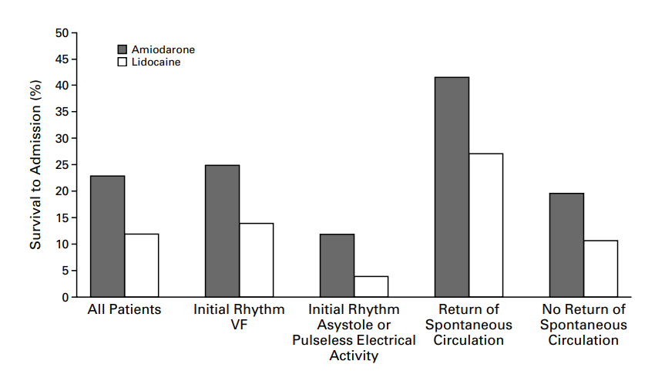
ALIVE (2002) - Results
Amiodarone survival to hospital admission vs. lidocaine (22.8% vs. 12.0%, p = 0.009)
Odds of survival by 12% for every minute delay between dispatch and drug admin
No difference in survival to hospital discharge (5% vs. 3%, p = 0.34)
Dorian et al. NEJM. 2002.
Notes:
Higher amiodarone dosing than modern practice, placebo used polysorbate 80 (making adverse effects more likely in lidocaine group than normal)
No data on neurologic outcomes
Trial moved guidelines away from lidocaine until ROC-ALPS

Slide 58
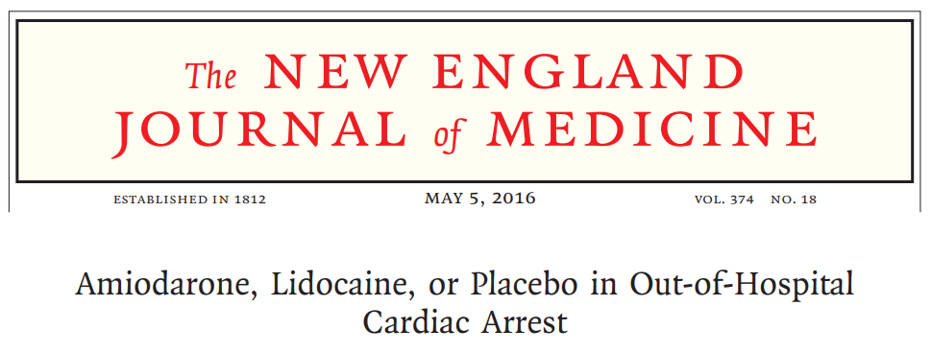
ROC-ALPS (2016)
Multicenter, double-blind RCT
N = 3026
Population: OHCA, ≥ 1 shocks
Trial Characteristics:
Mean 19.3 minutes from dispatch to drug administration
Median 3 shocks administered prior to study drug
Amiodarone
(300 + 150)
Lidocaine
(120 + 60)
Placebo
vs.
vs.
Primary Outcome: Survival to Hospital Discharge
Kudenchuk et al. NEJM. 2016.

Slide 59
ROC-ALPS (2016) - Results
Kudenchuk et al. NEJM. 2016.
Notes:
No difference in survival to hospital discharge between interventions
No difference in rates of favorable neurologic outcomes (per mRS)
Both amiodarone and lidocaine improved survival to hospital admission
Only lidocaine improved ROSC at ED arrival
Amiodarone associated with ↑ bradycardia
Lidocaine may ↓ adverse effects and ↑ ROSC compared to amiodarone
Subgroup analysis Suggests earlier administration (vs. after 3rd shock) may result in better outcomes

Slide 60
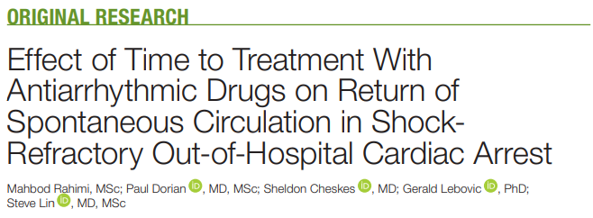
Rahimi et al. (2022)
Secondary analysis of ROC-ALPS trial (N = 2994)
Analyzed data to determine impact of time to drug administration on efficacy
Rahimi et al. JAHA. 2022.

Slide 61
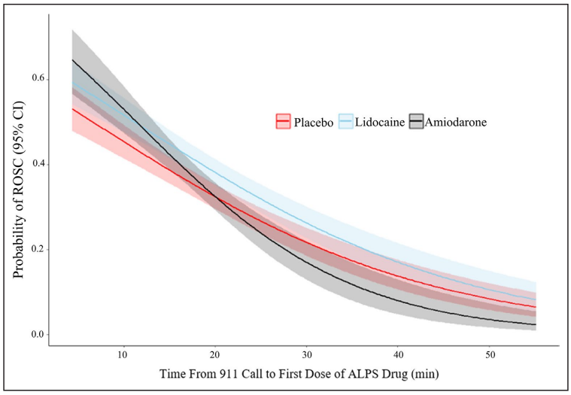
Rahimi et al. (2022) - Results
ROSC with time to drug administration
Lidocaine ROSC regardless of intervention timing (OR 1.29)
Amiodarone:
ROSC with early administration
ROSC with late administration
Inflection point:
13.5 min (vs. lidocaine)
19.5 min (vs. placebo)
13.5 min
19.5 min
Rahimi et al. JAHA. 2022.
Notes:
Key points: earlier admin = better ROSC, amiodarone is less effective with prolonged arrest, and lidocaine retains efficacy in late VF/VT arrest

Slide 62
Antiarrhythmic Drugs Summary
Conclusions from literature:
Amiodarone and Lidocaine likely result in similar outcomes in VF/pVT arrest
Older data suggests better outcomes with amiodarone
Modern data suggests lidocaine might be superior
Earlier antiarrhythmic drug administration may improve outcomes
Personal conclusions:
Either amiodarone or lidocaine are reasonable options in ACLS
Early in ACLS (< 15 min), both drugs are similar
Late in ACLS (> 15 min), lidocaine is preferred + amiodarone may be harmful
Consider earlier drug administration in shockable algorithm

Slide 63
Question V
Which of the following statements most accurately describes the data comparing lidocaine and amiodarone in ACLS?
Amiodarone improves neurologically favorable survival
Lidocaine is superior in improving survival to hospital discharge
Lidocaine may be more effective if given late in cardiac arrest
Amiodarone is associated with worse outcomes if given early

Slide 64
Conclusion

Slide 65
Areas of Uncertainty
Influence of Pharmacotherapy Timing
Optimal Dosing and Duration of Medications
Heterogeneity of Cardiac Arrest Phenotypes
OHCA vs. IHCA
Shockable vs. PEA vs. Asystole
Etiology of Cardiac Arrest

Slide 66
Optimal Outcomes in Cardiac Arrest
Return of Spontaneous Circulation (ROSC)
Survival to Hospital Admission
Survival to Hospital Discharge
Survival with Favorable Neurologic Outcome
Notes:
Which outcome is most important to study?
Which outcome is most important to practice?

Slide 67
Summary of Evidence
Controversy | Evidence | Recommendation
Epinephrine | ROSC Survival to Admission Survival to Discharge
Vasopressin | vs. epinephrine in combination
VSE | ROSC vs. epinephrine May Survival to Discharge and Favorable Neurologic outcomes | Insufficient evidence to make recommendation on VSE
Amiodarone vs. Lidocaine | Both survival to admission in Survival to Discharge or Favorable Neurologic Outcomes
Notes:
Optimal pharmacotherapy in cardiac arrest is controversial, owing to limited evidence and challenging study design in resuscitation
Overall body of evidence does not support proven neurologically favorable survival benefit associated with medication intervention
Current literature suggests improvement in ROSC and survival with current and proposed ACLS interventions

Slide 68
Questions?

Slide 69
References
Tsao CW, Aday AW, Almarzooq ZI, et al. Heart Disease and Stroke Statistics—2022 Update: A Report From the American Heart Association. Circulation. 2022;145(8). doi:10.1161/CIR.0000000000001052
Panchal AR, Bartos JA, Cabañas JG, et al. Part 3: Adult Basic and Advanced Life Support: 2020 American Heart Association Guidelines for Cardiopulmonary Resuscitation and Emergency Cardiovascular Care. Circulation. 2020;142(16_suppl_2). doi:10.1161/CIR.0000000000000916
Stiell IG, Wells GA, Field B, et al. Advanced cardiac life support in out-of-hospital cardiac arrest. N Engl J Med. 2004;351(7):647-656. doi:10.1056/NEJMoa040325
Sanghavi P, Jena AB, Newhouse JP, Zaslavsky AM. Outcomes After Out-of-Hospital Cardiac Arrest Treated by Basic vs Advanced Life Support. JAMA Intern Med. 2015;175(2):196. doi:10.1001/jamainternmed.2014.5420
Jacobs IG, Finn JC, Jelinek GA, Oxer HF, Thompson PL. Effect of adrenaline on survival in out-of-hospital cardiac arrest: A randomised double-blind placebo-controlled trial. Resuscitation. 2011;82(9):1138-1143. doi:10.1016/j.resuscitation.2011.06.029
Perkins GD, Ji C, Deakin CD, et al. A Randomized Trial of Epinephrine in Out-of-Hospital Cardiac Arrest. N Engl J Med. 2018;379(8):711-721. doi:10.1056/NEJMoa1806842
Ristagno G, Tang W, Huang L, et al. Epinephrine reduces cerebral perfusion during cardiopulmonary resuscitation. Crit Care Med. 2009;37(4):1408-1415. doi:10.1097/CCM.0b013e31819cedc9
Soar J, Böttiger BW, Carli P, et al. European Resuscitation Council Guidelines 2021: Adult advanced life support. Resuscitation. 2021;161:115-151. doi:10.1016/j.resuscitation.2021.02.010
Holmberg MJ, Issa MS, Moskowitz A, et al. Vasopressors during adult cardiac arrest: A systematic review and meta-analysis. Resuscitation. 2019;139:106-121. doi:10.1016/j.resuscitation.2019.04.008
Donnino MW, Salciccioli JD, Howell MD, et al. Time to administration of epinephrine and outcome after in-hospital cardiac arrest with non-shockable rhythms: retrospective analysis of large in-hospital data registry. BMJ. 2014;348(may20 2):g3028-g3028. doi:10.1136/bmj.g3028

Slide 70
References
Andersen LW, Kurth T, Chase M, et al. Early administration of epinephrine (adrenaline) in patients with cardiac arrest with initial shockable rhythm in hospital: propensity score matched analysis. BMJ. Published online April 6, 2016:i1577. doi:10.1136/bmj.i1577
Okubo M, Komukai S, Callaway CW, Izawa J. Association of Timing of Epinephrine Administration With Outcomes in Adults With Out-of-Hospital Cardiac Arrest. JAMA Netw Open. 2021;4(8):e2120176. doi:10.1001/jamanetworkopen.2021.20176
Callaham M, Madsen CD, Barton CW, Saunders CE, Pointer J. A randomized clinical trial of high-dose epinephrine and norepinephrine vs standard-dose epinephrine in prehospital cardiac arrest. JAMA. 1992;268(19):2667-2672.
Brown CG, Martin DR, Pepe PE, et al. A comparison of standard-dose and high-dose epinephrine in cardiac arrest outside the hospital. The Multicenter High-Dose Epinephrine Study Group. N Engl J Med. 1992;327(15):1051-1055. doi:10.1056/NEJM199210083271503
Stiell IG, Hebert PC, Weitzman BN, et al. High-dose epinephrine in adult cardiac arrest. N Engl J Med. 1992;327(15):1045-1050. doi:10.1056/NEJM199210083271502
Choux C, Gueugniaud PY, Barbieux A, et al. Standard doses versus repeated high doses of epinephrine in cardiac arrest outside the hospital. Resuscitation. 1995;29(1):3-9. doi:10.1016/0300-9572(94)00810-3
Sherman BW, Munger MA, Foulke GE, Rutherford WF, Panacek EA. High-dose versus standard-dose epinephrine treatment of cardiac arrest after failure of standard therapy. Pharmacotherapy. 1997;17(2):242-247.
Gueugniaud PY, Mols P, Goldstein P, et al. A comparison of repeated high doses and repeated standard doses of epinephrine for cardiac arrest outside the hospital. European Epinephrine Study Group. N Engl J Med. 1998;339(22):1595-1601. doi:10.1056/NEJM199811263392204
Wenzel V, Krismer AC, Arntz HR, et al. A comparison of vasopressin and epinephrine for out-of-hospital cardiopulmonary resuscitation. N Engl J Med. 2004;350(2):105-113. doi:10.1056/NEJMoa025431
Gueugniaud PY, David JS, Chanzy E, et al. Vasopressin and epinephrine vs. epinephrine alone in cardiopulmonary resuscitation. N Engl J Med. 2008;359(1):21-30. doi:10.1056/NEJMoa0706873

Slide 71
References
Part 7.2: Management of Cardiac Arrest. Circulation. 2005;112(24_supplement). doi:10.1161/CIRCULATIONAHA.105.166557
Neumar RW, Otto CW, Link MS, et al. Part 8: Adult Advanced Cardiovascular Life Support: 2010 American Heart Association Guidelines for Cardiopulmonary Resuscitation and Emergency Cardiovascular Care. Circulation. 2010;122(18_suppl_3). doi:10.1161/CIRCULATIONAHA.110.970988
Link MS, Berkow LC, Kudenchuk PJ, et al. Part 7: Adult Advanced Cardiovascular Life Support: 2015 American Heart Association Guidelines Update for Cardiopulmonary Resuscitation and Emergency Cardiovascular Care. Circulation. 2015;132(18_suppl_2). doi:10.1161/CIR.0000000000000261
Andersen LW, Isbye D, Kjærgaard J, et al. Effect of Vasopressin and Methylprednisolone vs Placebo on Return of Spontaneous Circulation in Patients With In-Hospital Cardiac Arrest: A Randomized Clinical Trial. JAMA. 2021;326(16):1586. doi:10.1001/jama.2021.16628
Ito T, Saitoh D, Takasu A, Kiyozumi T, Sakamoto T, Okada Y. Serum cortisol as a predictive marker of the outcome in patients resuscitated after cardiopulmonary arrest. Resuscitation. 2004;62(1):55-60. doi:10.1016/j.resuscitation.2004.02.004
Liu B, Zhang Q, Li C. Steroid use after cardiac arrest is associated with favourable outcomes: a systematic review and meta-analysis. J Int Med Res. 2020;48(5):300060520921670. doi:10.1177/0300060520921670
Prigent H, Maxime V, Annane D. Clinical review: corticotherapy in sepsis. Crit Care. 2004;8(2):122-129. doi:10.1186/cc2374
Tsai MS, Huang CH, Chang WT, et al. The effect of hydrocortisone on the outcome of out-of-hospital cardiac arrest patients: a pilot study. The American Journal of Emergency Medicine. 2007;25(3):318-325. doi:10.1016/j.ajem.2006.12.007
Tsai MS, Chuang PY, Yu PH, et al. Glucocorticoid use during cardiopulmonary resuscitation may be beneficial for cardiac arrest. International Journal of Cardiology. 2016;222:629-635. doi:10.1016/j.ijcard.2016.08.017
Tsai MS, Chuang PY, Huang CH, et al. Postarrest Steroid Use May Improve Outcomes of Cardiac Arrest Survivors. Crit Care Med. 2019;47(2):167-175. doi:10.1097/CCM.0000000000003468

Slide 72
References
Mentzelopoulos SD, Zakynthinos SG, Tzoufi M, et al. Vasopressin, epinephrine, and corticosteroids for in-hospital cardiac arrest. Arch Intern Med. 2009;169(1):15-24. doi:10.1001/archinternmed.2008.509
Mentzelopoulos SD, Malachias S, Chamos C, et al. Vasopressin, Steroids, and Epinephrine and Neurologically Favorable Survival After In-Hospital Cardiac Arrest: A Randomized Clinical Trial. JAMA. 2013;310(3):270-279. doi:10.1001/jama.2013.7832
Lexicomp. Amiodarone.
Lexicomp. Lidocaine.
Panchal AR, Berg KM, Kudenchuk PJ, et al. 2018 American Heart Association Focused Update on Advanced Cardiovascular Life Support Use of Antiarrhythmic Drugs During and Immediately After Cardiac Arrest: An Update to the American Heart Association Guidelines for Cardiopulmonary Resuscitation and Emergency Cardiovascular Care. Circulation. 2018;138(23). doi:10.1161/CIR.0000000000000613
Kudenchuk PJ, Cobb LA, Copass MK, et al. Amiodarone for resuscitation after out-of-hospital cardiac arrest due to ventricular fibrillation. N Engl J Med. 1999;341(12):871-878. doi:10.1056/NEJM199909163411203
Dorian P, Cass D, Schwartz B, Cooper R, Gelaznikas R, Barr A. Amiodarone as compared with lidocaine for shock-resistant ventricular fibrillation. N Engl J Med. 2002;346(12):884-890. doi:10.1056/NEJMoa013029
Kudenchuk PJ, Brown SP, Daya M, et al. Amiodarone, Lidocaine, or Placebo in Out-of-Hospital Cardiac Arrest. N Engl J Med. 2016;374(18):1711-1722. doi:10.1056/NEJMoa1514204
Rahimi M, Dorian P, Cheskes S, Lebovic G, Lin S. Effect of Time to Treatment With Antiarrhythmic Drugs on Return of Spontaneous Circulation in Shock‐Refractory Out‐of‐Hospital Cardiac Arrest. JAHA. 2022;11(6):e023958. doi:10.1161/JAHA.121.023958
Wagner D, Kronick SL, Nawer H, Cranford JA, Bradley SM, Neumar RW. Comparative Effectiveness of Amiodarone and Lidocaine for Treatment of In-Hospital Cardiac Arrest (IHCA). Chest. Published online November 2022:S0012369222040399. doi:10.1016/j.chest.2022.10.024

Slide 73
H’s + T’s
H’s | T’s
Hypoxia | Toxins
Hypovolemia | Thrombosis (Myocardial Infarction)
Hypothermia | Thrombosis (Pulmonary Embolism)
Hyper/Hypokalemia | Tension Pneumothorax
Hydrogen ion excess (Acidosis) | Tamponade (Cardiac)
Hypoglycemia
Panchal et al. Circulation. 2020.
Notes:
Reversible causes in cardiac arrest -> most associated with PEA

Slide 74
Limitations of Cardiac Arrest Research
Ethical Considerations
Challenges in Study Design
Confounders with Observational Research
Comparisons with standard of care vs. placebo
Difficulties with informed consent
Impossible to control for all aspects of care
Especially prevalent in OHCA literature

Slide 75
Refractory VF
Defined as VF unresponsive to ≥ 3-5 defibrillations + epinephrine + antiarrhythmic drug administration
Options
Double Sequential Defibrillation (DSD)
Esmolol
Cheskes et al. NEJM. 2022.
Henry Schein. Esmolol.

Slide 76
Double Sequential Defibrillation
Use of second set of defibrillator pads to administer two sequential shocks in rapid succession
Rationale for Use:
Enhanced energy delivery
Change in defibrillation vector
First shock may potentiate efficacy of second defibrillation
Early case series and animal models demonstrated efficacy in terminating cardiac arrest
Cortez et al. Resuscitation. 2016.
Cheskes et al. NEJM. 2022.
Notes:
Change in vector of defibrillation may allow for different areas of myocardium to undergo defibrillation, potentially improving ROSC chance. Certain areas might be more implicated in benefit
First shock may induce transient period of myocardial electrical instability that might be more amenable to defibrillation than refractory VF situation
Earlier case studies (Cortez et al. – 2016) – demonstrated potential efficacy but were limited in sample size/trial design
Limitations:
Requires 2 defibrillators
Staff training to administer shocks appropriately
Pad positioning requires proper training
Possible risk to equipment if shocks given incorrectly

Slide 77
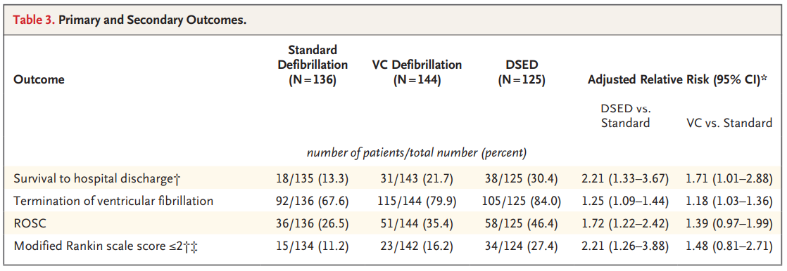
DOSE-VF (2022)
Multicenter RCT (N = 405)
Compared DSD vs. vector change vs. standard defibrillation
Cheskes et al. NEJM. 2022.
Notes:
DOSE-VF
Compared outcomes in refractory VF arrest (failed 3 standard defibrillations)
Stopped early due to the pandemic (underpowered and might be spurious findings)
Fragility index for VCD was 1 w/ 1 patient lost to follow-up
Pilot trial data was added to main trial -> possibly compromising internal validity

Slide 78
Esmolol
Rationale for Use:
Ultra short-acting β-1 antagonist -> blunts catecholamine-mediated electrical activity
May reduce arrhythmogenicity, lower the defibrillation threshold, decrease myocardial oxygen demand, and improve maintenance of normal rhythm
Evidence:
Driver et al. (2014) – Case series (N = 6 esmolol, 19 control)
Demonstrated ROSC, survival to hospital admission, and favorable neurologic outcomes in patients treated with esmolol vs. control
Lee et al. (2016) – Retrospective cohort (N = 16 esmolol, 25 control)
Esmolol ROSC and survival to hospital admission (56% vs. 16%, p = 0.007)
No difference in survival to 30 days or favorable neurologic outcomes
Driver et al. Resuscitation. 2014.
Lee et al. Resuscitation. 2016.
Notes:
Driver et al. -> extremely small study, not powered for outcomes (no statistically significant difference noted given low sample size). Control arm had longer pre-hospital down time and longer total CPR duration, possibly biasing outcomes.
Lee et al. -> better overall study, still limited with small sample size and limitations of retrospective study. Esmolol patients had higher amiodarone dosing. Median shocks before esmolol was 6.

